Slide 1
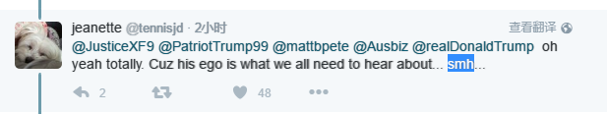
SMH=Shaking My Head

Slide 2
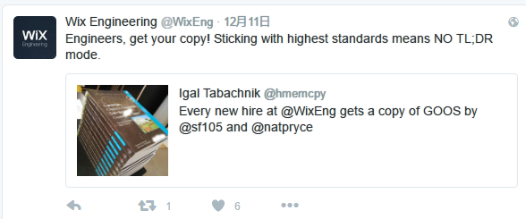
TL;DR=Too Long; Didn't Read

Slide 3
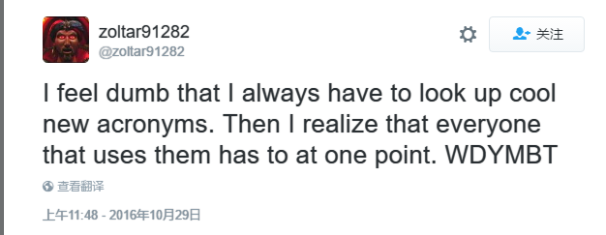
WDYMBT=What Do You Mean By That?

